Slide 1
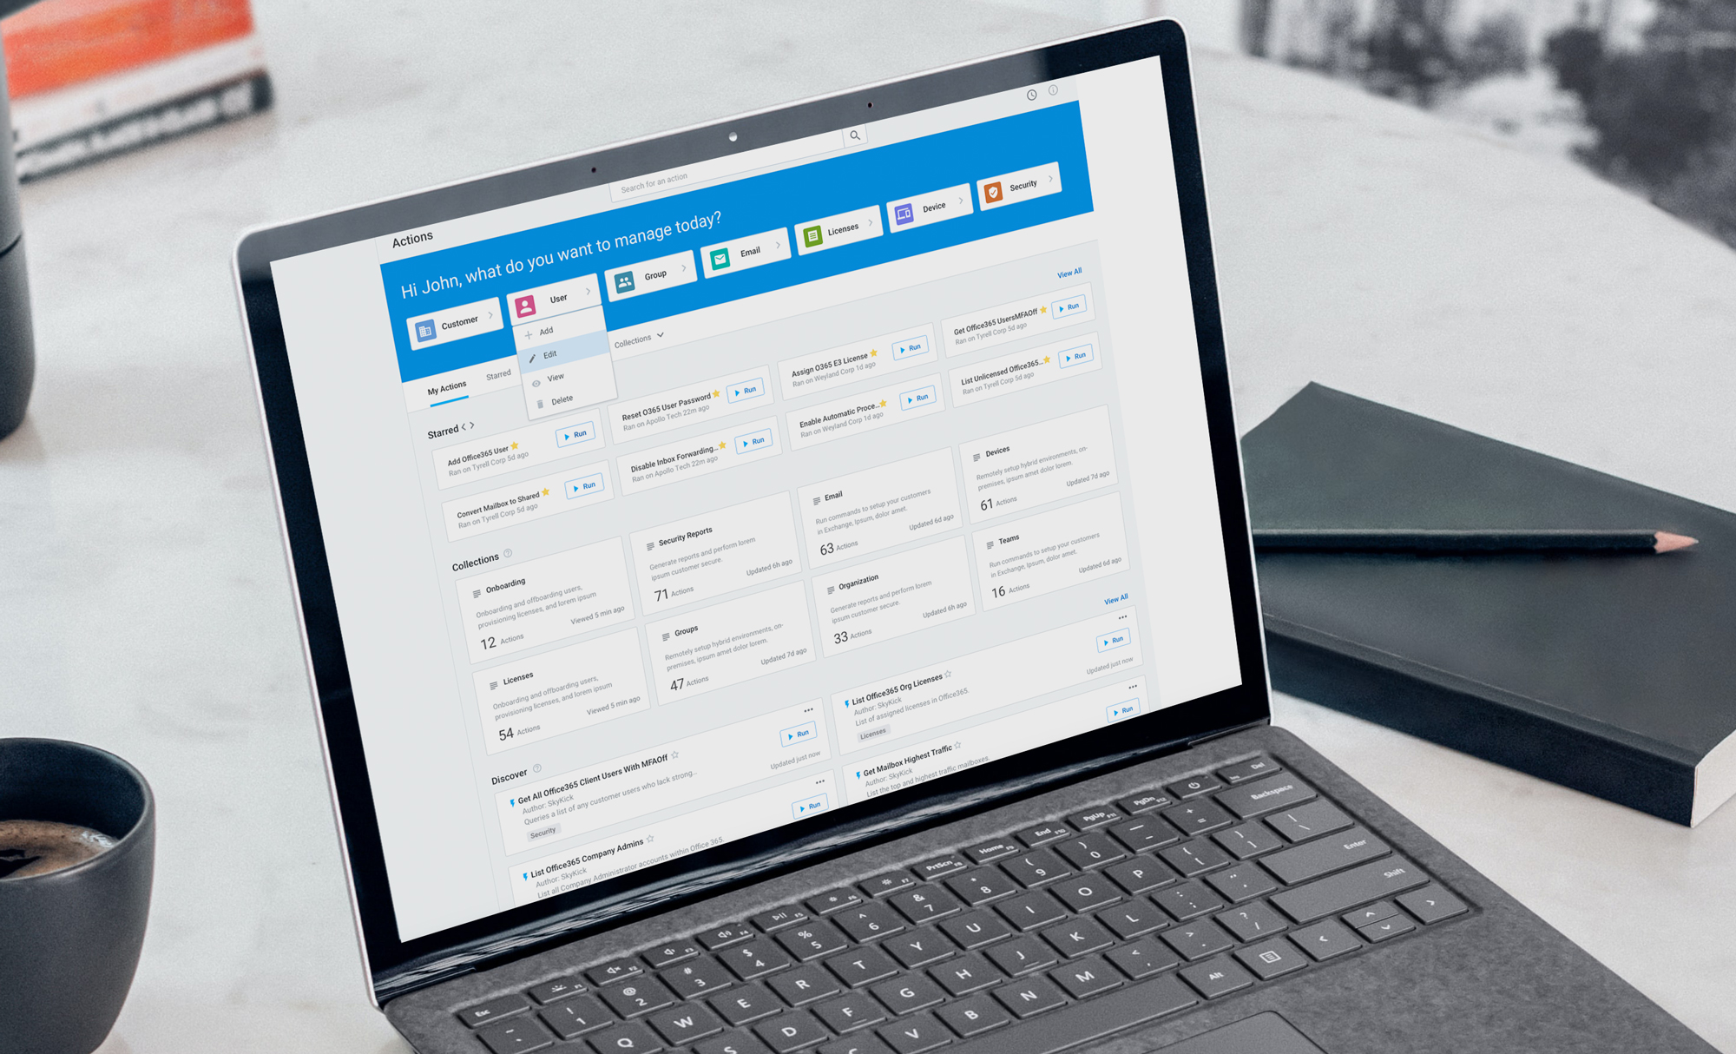
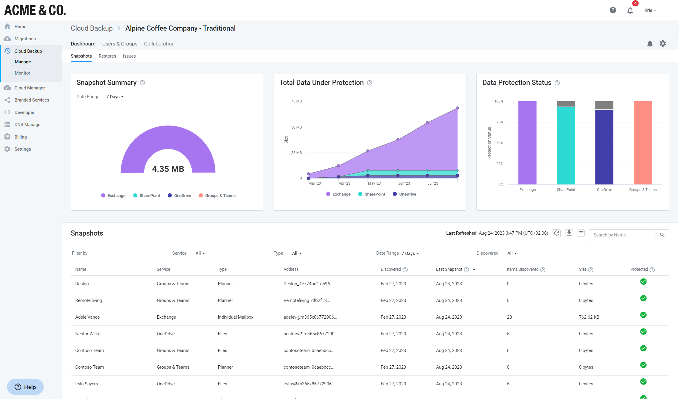
Introducing
Intelligent Backup

Slide 2
Agenda
SkyKick Overview SkyKick Backup Overview Demo Setup SkyKick Cloud Backup Cloud Backup Branded Services Monitoring and Alert Notifications SkyKick Intelligent Backup what’s New SkyKick Resources Q & A

Slide 3
SkyKick Cloud Backup for Microsoft 365
The most intelligent solution for secure, automated & customer-centric data protection
Customer Value
Automated
Secure
Maximize customer impact
Do more with less using powerful automation
Deliver enterprise-grade peace of mind
Smart Insights
Snap Search
Persistent Backup (Up to 6x & Fully Retained)
Unlimited Storage and Retention
Cloud-Native
Groups Management
Branded Customer Self-Service
Modern App-Only Authentication
Enterprise-Level Certifications
Granular Recovery Options
Engineered in the Microsoft Cloud

Slide 4
The most complete Microsoft 365 backup solution
Exchange Online
SharePoint Online
OneDrive for Business
MS Teams & Groups
Planner
BACKUP
Email, Calendar, Contacts
Tasks, Notes, Journal
Public Folders & Shared Mailboxes
Classic Team Sites
Subsites
Lists
Files* and versions
Full account
Folders
Files* and versions
Channels: Private and Public
Teams Chat
Planner
Files* and versions
All plans, tasks, buckets
Single item or bulk restore
Full mailbox restore
Cross-mailbox restore
Point-in-time restore
Single item or bulk restore
Restoration of entire site collection and subsites
Point-in-time restore
Single item or bulk restore
Full account recovery
Point-in-time restore
Single item or bulk restore
Full restore of Teams and channels
Full restore of posts and chat
Single item or bulk restore
Full restore of Planner
RESTORE

Slide 5
Encrypted and secure: GDPR-compliant backups on servers in EU
Your backup data stored securely in data center location of your choice anywhere in Europe, never leaving the secure Azure cloud
You comply with legal provisions and security & privacy compliance requirements.
SkyKick is GDPR compliant, ISO 27001 & Data Pro + certified and a Cloud Security Alliance Trusted Cloud Provider
General Data Protection Regulation: Customers must have backup and recovery in place in case of data loss​
Reliable and secure: cloud backup is engineered and secured within the Microsoft ecosystem, benefitting from cutting-edge security – additionally secured by SkyKick with a 2048-bit encryption - and 256-bit for end-to-end transmission
Modern App-Only Authentication: Secure access leveraging latest Microsoft APIs

Slide 6
SkyKick Cloud Backup subscription creation and configuration

Slide 7
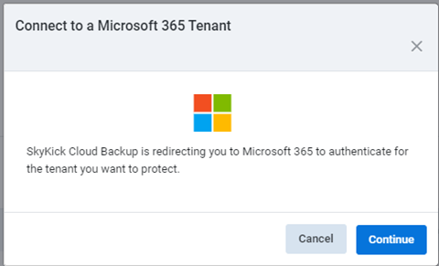
Cloud Backup Set Up: Get Started
https://support.skykick.com/hc/en-us/articles/11878217248147-Cloud-Backup-subscription-creation-and-configuration-Updated-

Slide 8
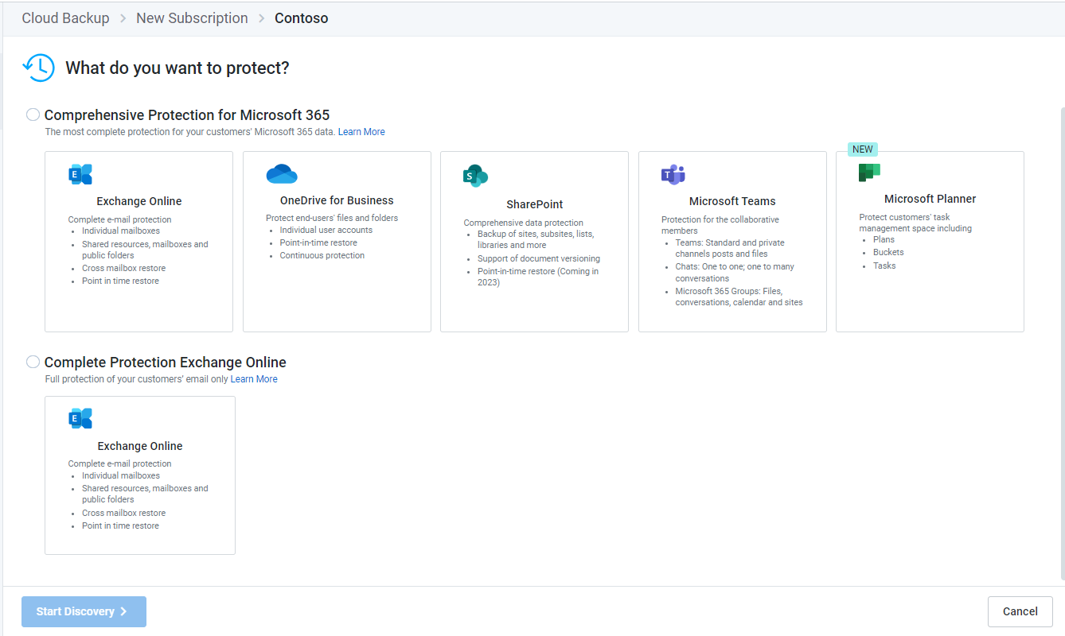
Cloud Backup Set Up: Select the data for protection

Slide 9
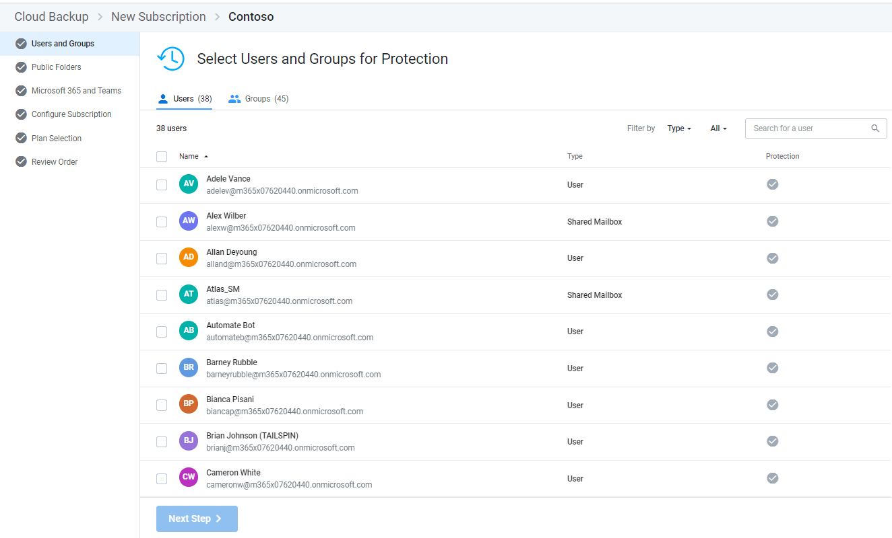
Cloud Backup Set Up: Select the users for data protection

Slide 10
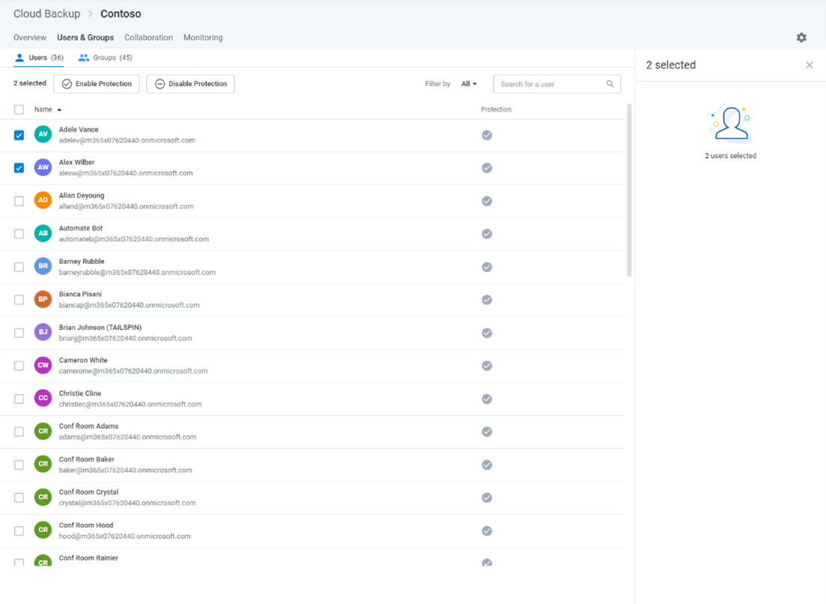
Cloud Backup Set Up: Select users individually

Slide 11
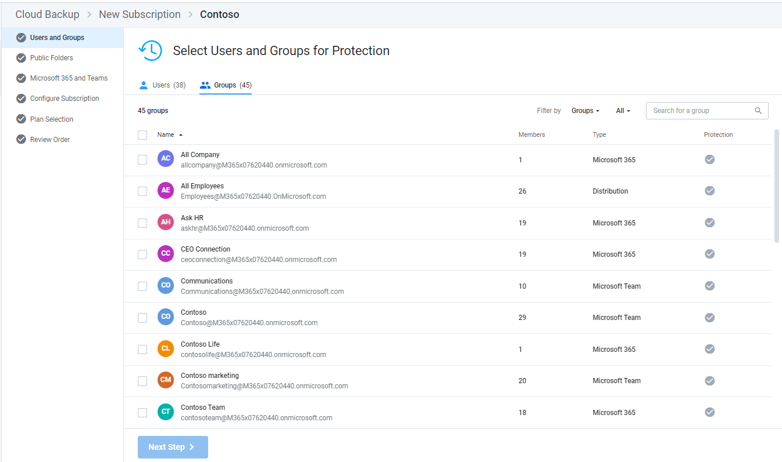
Cloud Backup Set Up: Select users by group membership

Slide 12
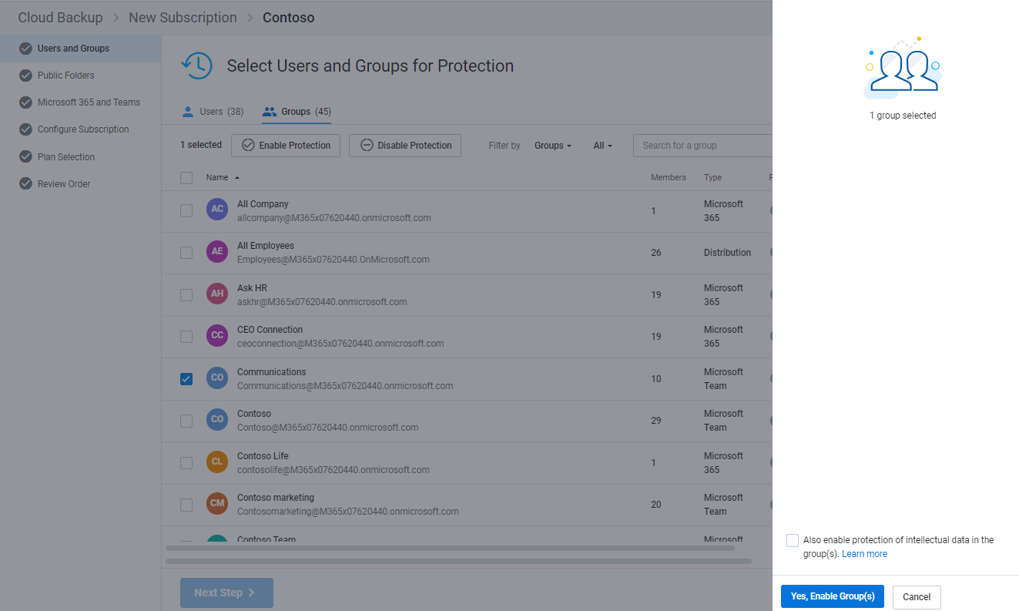
Cloud Backup Set Up: Select users by group membership

Slide 13
Cloud Backup Set Up: Select Public Folders for protection

Slide 14
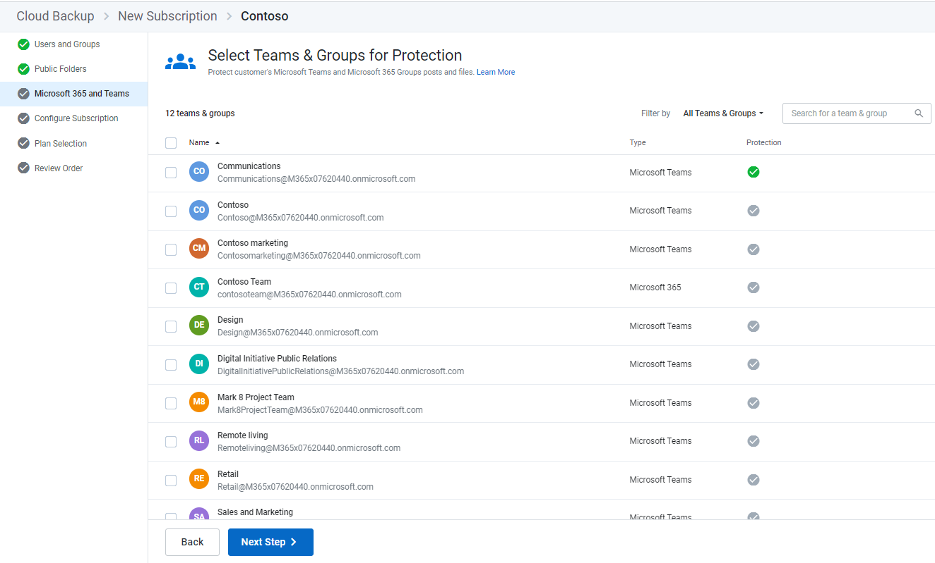
Cloud Backup Set Up: Select Microsoft 365 Teams and group data for protection

Slide 15
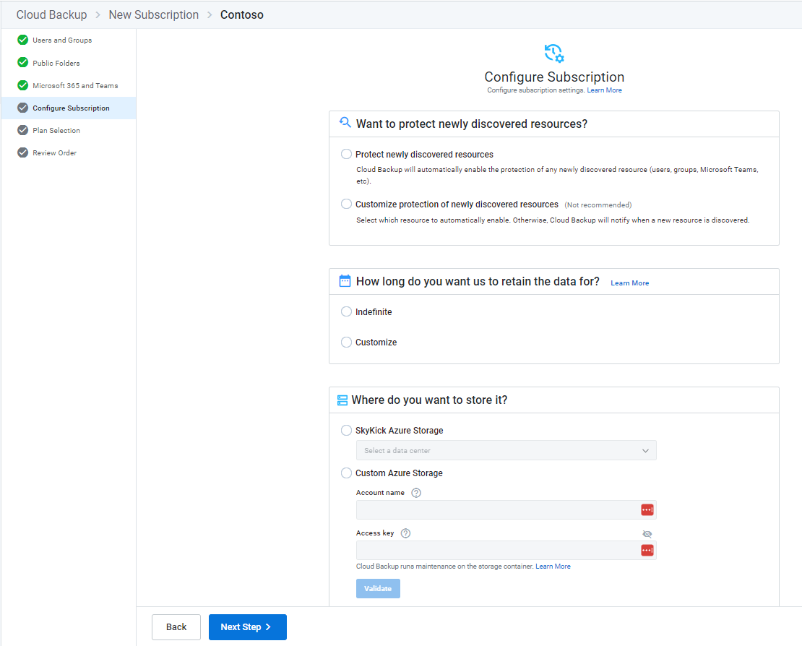
Cloud Backup Set Up: Configure the subscription

Slide 16
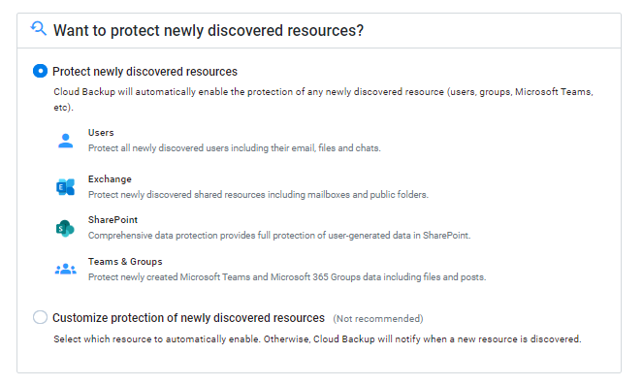
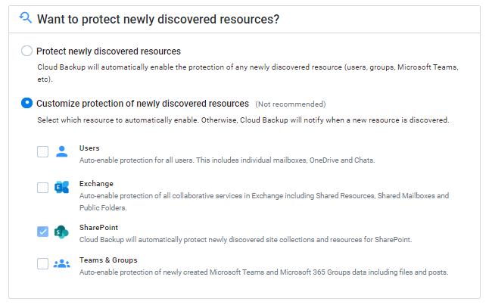
Cloud Backup Set Up: Protect newly discovered resources

Slide 17
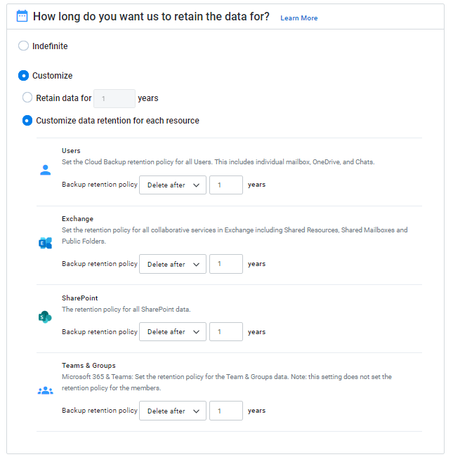
Cloud Backup Set Up: Configure data retention

Slide 18
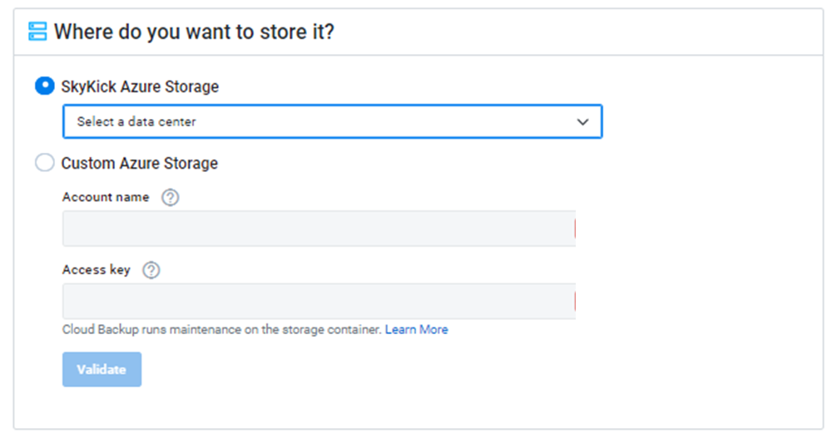
Cloud Backup Set Up: Select storage location

Slide 19
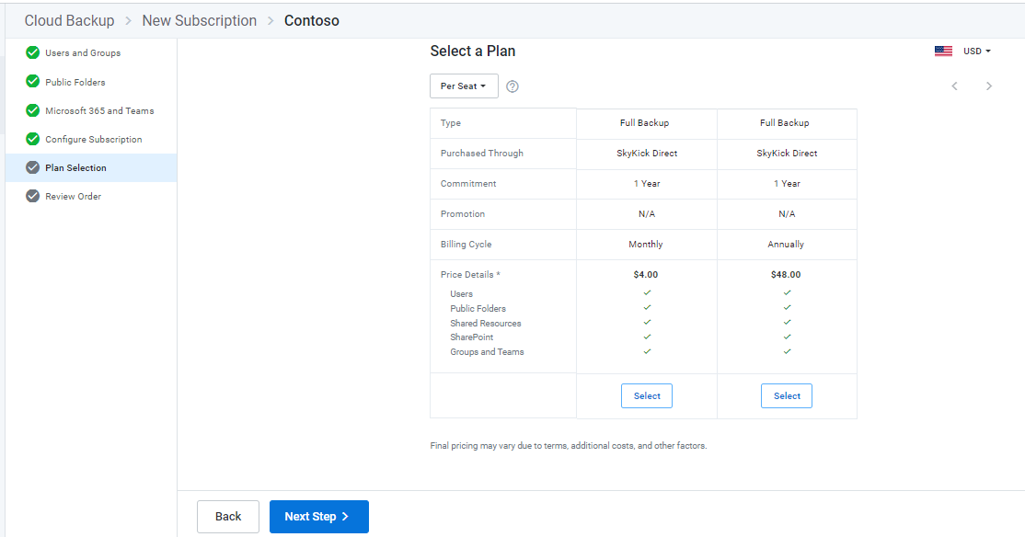
Cloud Backup Set Up: Select a plan

Slide 20
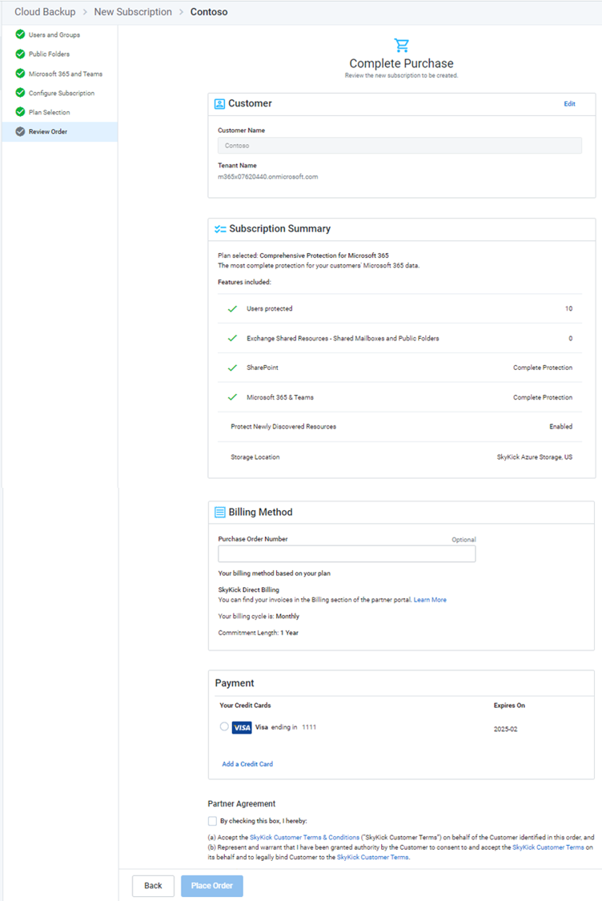
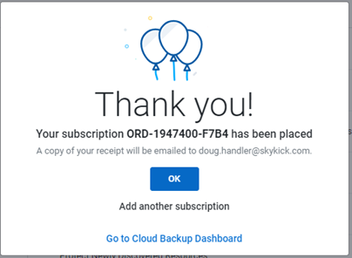
Cloud Backup Set Up: Review order and complete purchase

Slide 21
Demo

Slide 22
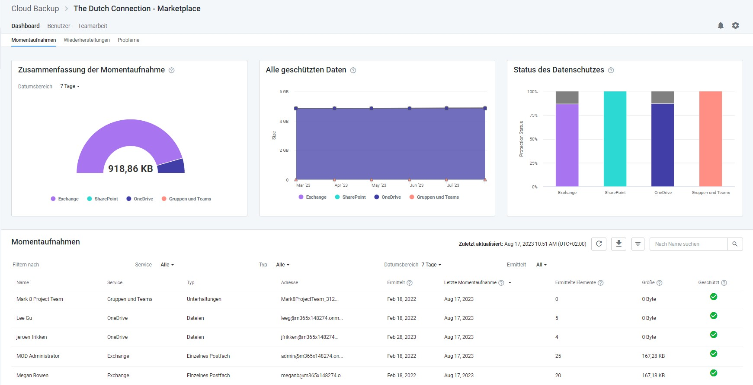
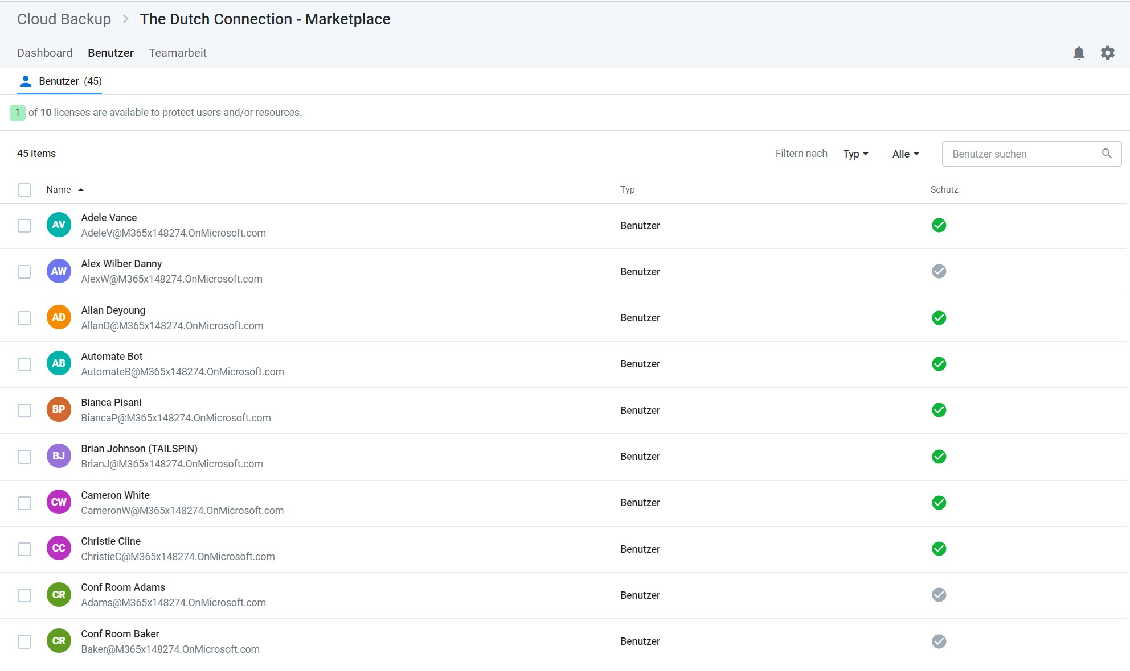
In a nutshell: The key differences to the previous Skykick Cloud Backup!
SkyKick Intelligent Backup for Microsoft 365
Your Autopilot for Microsoft 365 Data Protection
New dashboard with Smart Insights
Fresh UI with user-centric organization in modern M365 look
MS Planner backups & restores
Direct help-center access for customers
SharePoint Point-in-Time Restores + granular point in time restores for folders & files for all solutions
Group Management for simplified user management

Slide 23
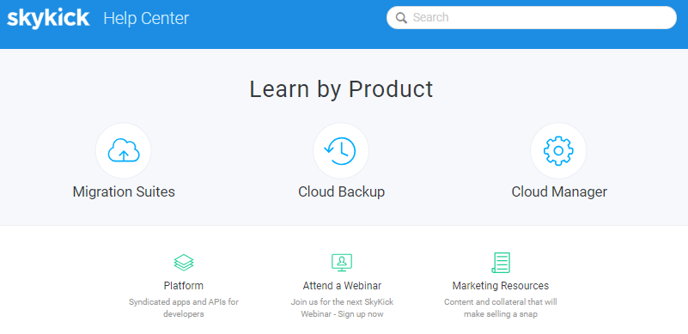
Portal Resources: Partner documentation & Customer talk tracks
https://support.skykick.com/hc/en-us/categories/200451257-Cloud-Backup
Help Center | Blog | Live Webinars | Marketing Resources

Slide 24
Working with the SkyKick Partner Success Team
Email:
Support@skykick.com
Phone:
Check website
Call SkyKick Support
Needed information
Partner Name
MPN ID
Name of the backup subscription
Pin Code
Email SkyKick Support
Subject format:
[subscription Name] – “Issue”
Dedicated team for the EMEA region
SkyKick Support is available in the English, Spanish, French & German language
Phone Support in the EMEA: Monday – Friday 24 hours a day
https://www.skykick.com/support/get-support/

Slide 25
Thank You !

